Slide 1
An Empirical Study on the Rewritability of the with Statement in JavaScript
Changhee Park
(Joint work with Hongki Lee and Sukyoung Ryu)
PLRG @ KAIST
October 23, 2011

Slide 2
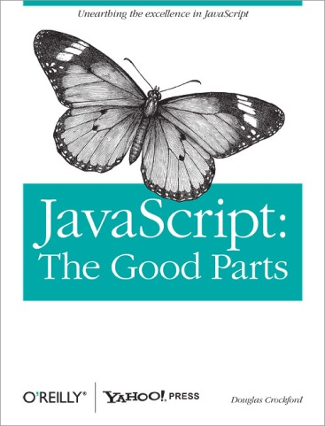
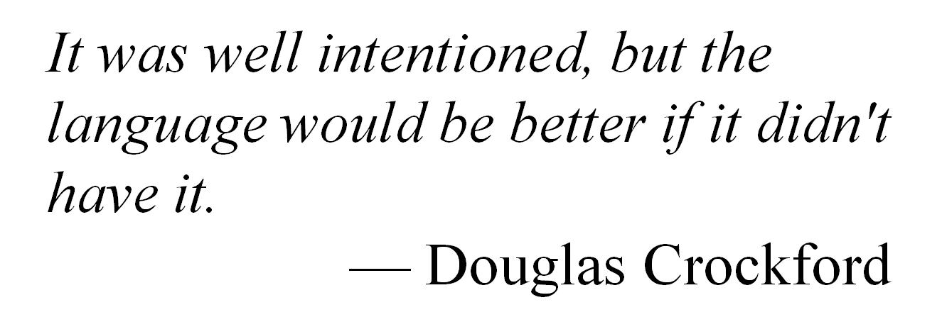
Famous Word about the with Statement

Slide 3
Overview
Introduction of the with statement
Real-world usage patterns of the with statement
Rewritability of the with statement
Future work
Conclusion

Slide 4
Introduction
Syntax in ECMAScript
The body of the with statement

Slide 5
Introduction
Semantics
Evaluate exp to a JavaScript object(with object)
Add the object to the front of the scope chain
All properties in the with object become local variables in the body of the with statement
Evaluate stmt
Remove the with object from the scope chain

Slide 6
Good Parts
document
body
div
An HTML document
A DOM(Document Object Model) tree

Slide 7
Good Parts

Slide 8
Bad Parts
Introducing a new scope at run time
Performance overhead
Infeasible static analysis

Slide 9
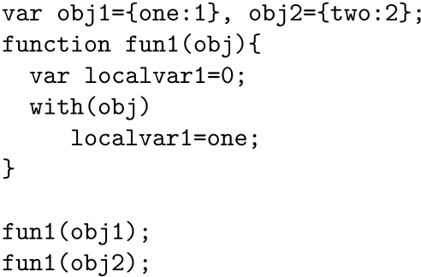
Bad Parts
Infeasible static analysis
Global
obj1, obj2, fun1
fun1
obj, localvar1

Slide 10
Bad Parts
Infeasible static analysis
Global
obj1, obj2, fun1
fun1
obj, localvar1
with : obj1
one

Slide 11
Bad Parts
Infeasible static analysis
Global
obj1, obj2, fun1
fun1
obj, localvar1
with : obj2
two

Slide 12
Empirical Study
with statements used in real-world
Amount
Usage patterns

Slide 13
Methodology
Real-world JavaScript code
100(98) worldwide most popular web sites by alexa.com
Tool
TracingSafari, Purdue University
Customized version of WebKit
Static analyzer using the Rhino parser

Slide 14
Methodology
Two data sets
- LOADING set
JavaScript code collected for 30s at loading time
- INTERACTION set
JavaScript code collected for 2 minutes with user interactions(mouse click events)

Slide 15
Methodology
Three kinds of with statement
Static with statements
Static with keyword detected by the Rhino Parser (static)
Executed with statements
with statements evaluated by the interpreter (executed)

Slide 16
Methodology
Three kinds of with statement
Dynamic with statements
Dynamically instrumented and executed with statements (dynamic)
By filtering out static with statements from executed with statements

Slide 17
Amount of with Statements
LOADING set
Type of with | Web sites | with counts | Unique withs
Static | 15 | 54 | 54
Executed | 8 | 36 | 12
Dynamic | 2 | 13 | 5
Duplicates
0%
66.6%
61.5%
INTERACTION set
Type of with | Web sites | with counts | Unique withs
Static | 38 | 2,245 | 573
Executed | 27 | 1,232 | 215
Dynamic | 9 | 308 | 56
Duplicates
74.4%
82.5%
81.8%

Slide 18
Usage Patterns
Seven usage patterns
DOMAccess pattern
This pattern
Global pattern
Empty pattern
Template pattern
Generator pattern
Others pattern

Slide 19
Usage Patterns
1. DOMAccess pattern
with object : DOM element
Example from paypal.com
Access or change the values of DOM element attributes

Slide 20
Usage Patterns
2. This pattern
with object : this

Slide 21
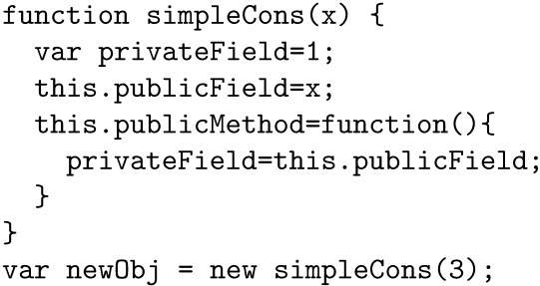
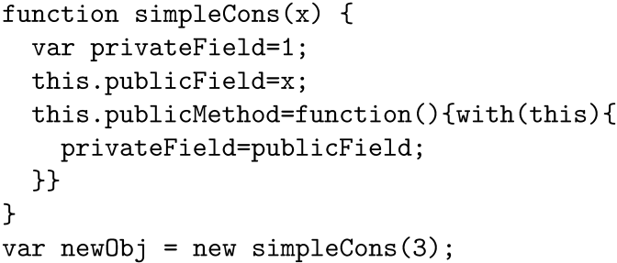
Usage Patterns
2. This pattern
Use the same naming convention between private and public properties

Slide 22
Usage Patterns
3. Global pattern
with object : window
Example from ebay.com
Run the code by eval under the global scope

Slide 23
Usage Patterns
4. Empty pattern
with object : any object
Has the empty body

Slide 24
Usage Patterns
5. Template pattern
with object : template data
Example from 163.com
Process HTML templates

Slide 25
Usage Patterns
6. Generator pattern
with object : any object
Contains dynamic code generating functions such as eval, Function, setTimeout, and setInterval

Slide 26
Usage Patterns
7. Others pattern
with object : any object
Avoid repeatedly accessing the with object

Slide 27
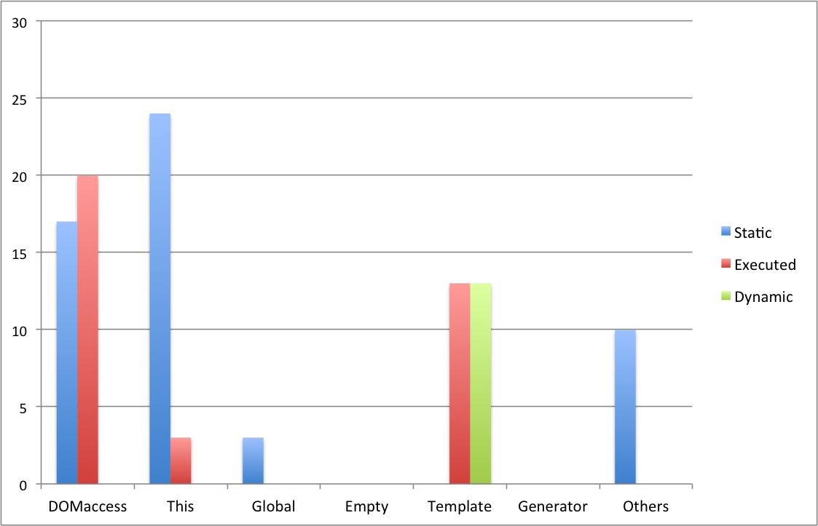
Usage Patterns
LOADING set

Slide 28
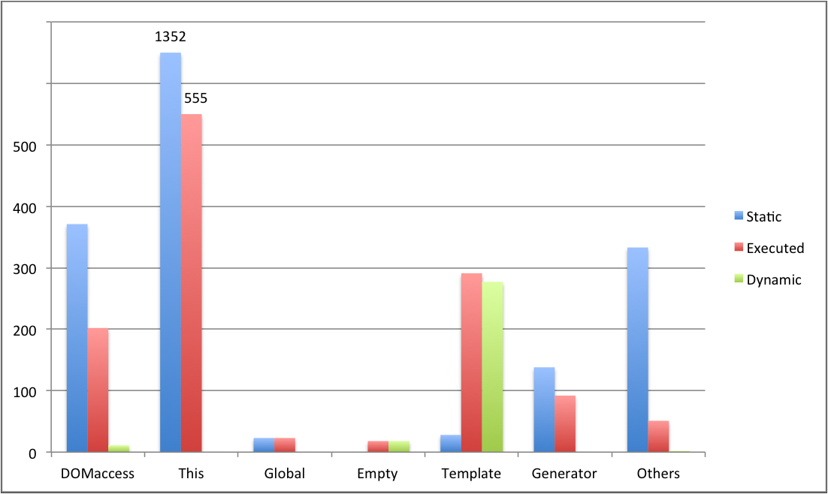
Usage Patterns
INTERACTION set

Slide 29
Template Pattern in Dynamic with
Example from 163.com
For an arbitrary tag?
Only process <a> tag
Generate new process code with an input tag

Slide 30
Rewritability of with Statements
Many static approaches disallow the with statement
Safe subsets of JavaScript
Google | Facebook | YAHOO!
Cajita | FBJS | ADsafe
What if it is possible to rewrite the with statement to other statements?

Slide 31
Rewriting Strategy
Main idea
obj has the id property?
Yes
No

Slide 32
Rewriting Strategy
Main idea

Slide 33
Rewriting Strategy
Rewriting the assignment expression
ReferenceError exception!!

Slide 34
Rewriting Strategy
Rewriting the assignment expression

Slide 35
Rewriting Strategy
Rewriting the variable declaration
v

Slide 36
Rewriting Strategy
Rewriting the function expression
v

Slide 37
Rewritability Check
Rewritability of with statements in each pattern
Pattern | Rewritability | Rewriting
DOMAccess | Yes | By the rewriting strategy
This | Yes | By the rewriting strategy
Global | Yes
Empty | Yes | By the rewriting strategy
Template | Yes | By the rewriting strategy
Generator | No
Others | Yes | By the rewriting strategy

Slide 38
Rewritability Check
Generator pattern
Not possible to rewrite in general!!

Slide 39
Rewritability Check
Global pattern : example from ebay.com

Slide 40
Rewritability Check
According to the ECMAScript 5th edition, rewriting is possible by aliasing

Slide 41
Rewritability Check
Summary
We can rewrite all static with statements in all patterns except for Generator pattern
100% of static with statements in the LOADING set and 93.8% in the INTERACTION set are rewritable

Slide 42
Future Work
Extension to the top 1,000 sites
Formalization of the rewriting process
Implementation of the rewriting process

Slide 43
Conclusion
Usage of with statements in real world
38% of the top 98 sites have static occurrences of with statements with simple user interactions
Rewritability of with statements
We can rewrite all static with statements to other statements if the with statements do not have dynamic code generating functions

